Slide 1


Code & Learn Workshop
Basic CRUD Web Apps R ‘shiny’ vs Python Flask
09/26/2018

Slide 2


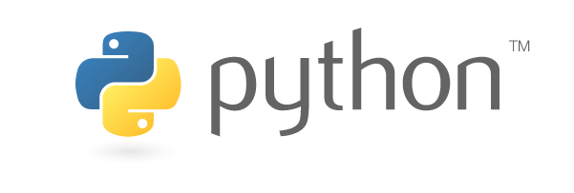

CRUD Web Apps - Overview
CRUD – Create, Read, Update, Delete
R/shiny Overview
Introduction
UI, Server
Python/Flask Overview
Introduction
Stack build

Slide 3
CRUD Applications
Most apps have some sort of CRUD functionality
Create : Add new data entries (CREATE)
Read : Review existing data entries (SELECT)
Update : Modify existing data entries (UPDATE)
Delete : Remove existing data entries (DELETE)
Components
GUI (HTTP, CSS, Javascript)
Data Storage (often SQL)
Framework (Flask, Django, many others… for “real apps”)
Connectivity/Security

Slide 4
R Programming Language
What is R?
Specialized, Open-Source Programming Language
Data Management, Statistics/Biostatistics, Machine Learning
Commonly used by researchers, analysts, data scientists (statisticians)
Roots in “S” programming language (circa 1976)
Useful libraries for app build
‘tidyverse’ framework
Includes dplyr, ggplot2, tidyr, readr, purrr, tibble, stringr, forcats packages
‘shiny’ package
Allows inputs/outputs into R via a customizable GUI

Slide 5
R Programming - Shiny
UI component
Overall appearance of the application
Manual data entry inputs (fields, checkboxes, sliders)
Graphical outputs & summary tables
Server component
The “guts” of the application
Calls to functions for data wrangling, calculations
Graphical outputs displayed in the GUI are defined here

Slide 6
R Shiny - Pros and Cons
Pros:
Quick to build a basic app
Many templates available from the R community
HTML/CSS/GUI is dynamically generated by ‘shiny’ package
Reactive functions with smooth graphics, interactive graphs
Cons:
Complex workarounds required for >16 users
Authentication protocols can challenging to implement
Use cases for ‘R shiny’ tend to be somewhat limited

Slide 7
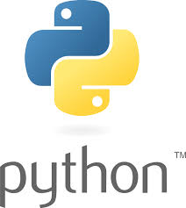
Python Programming Language
What is Python?
All-purpose, Open-Source Programming Language
It can do practically anything
Commonly used people that program things
Released in 1991
Useful libraries for app build
‘pandas’ library
Good for data manipulation/cleaning
‘flask’ framework
Ideal for development of simple web apps

Slide 8

Python Programming - Flask
A Basic Flask Stack
Python scripts
__init__.py : “App Factory”
db.py : defines how data should be handled by the app
auth.py : contains protocols for authentication (security)
blog.py : defines how data is stored/displayed for a blog
setup.py : defines a wrapper for installing the app
Template scripts
GUI: HTML, CSS, and JavaScript
SQL schema
Database: SQL defines table properties for a SQLite Db

Slide 9
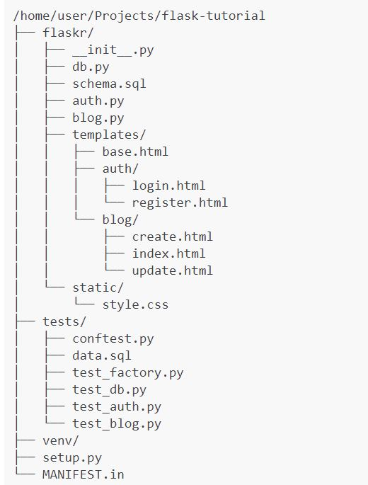
Python Programming - Flask
Flask tutorial
Automated QA Testing
Security/Authentication

Slide 10
Python/Flask - Pros and Cons
Pros:
More customizable than R ‘shiny’
More scalable than R ‘shiny’
Python enforces indentation, makes syntax more readable
Basic QA testing can be automated
Cons:
At minimum, app build requires knowledge of Python, SQL, HTML, CSS
App design can vary greatly… tutorial is possibly simplest example
Requires greater investment of time (design, planning, QA testing)

Slide 11
Thanks for attending!
Next Code & Learn will be…
10/10/2018, same place, same time
Guest Speaker(s) – PDX Wildlife
Conservation Biology Non-Profit
Pandas, Elephants, and Habitat Conservation Projects
Requirements Gathering for a Web App

